Slide 1



Ait614-Big Data Essentials-Sec001
Bridges at Risk: Coastal vs Inland Environment impacts on lifespan and maintenance
Under guidance of Dr. Lindi Liao
George Mason University
Team Members: Team 1
Saivarun Tanjore Raghavendra
Mohammed Tareq Sajjad Ali
Mano Sappa Harsha
Vasishta Chandala
Suraj Poldas
Big Data in Action

Slide 2
Introduction
Bridges are critical structures for connectivity and economic growth, with service life influenced by design, materials, traffic load, and environmental factors.
Environmental Stressors:
Coastal regions face unique weather patterns, including high humidity and salt exposure.
Inland regions experience temperature extremes and freeze-thaw cycles, accelerating structural aging.
Research Objectives:
Analyze differences in bridge deterioration between coastal and inland regions.
Apply K-means clustering to uncover condition patterns.
Develop an ensemble model (Random Forest, XGBoost, Neural Networks) to predict bridge risk levels.
Outcome:
Support transportation agencies in resource allocation, maintenance prioritization, and policy formulation for resilient bridge infrastructure.

Slide 3
Objectives
Investigate regional differences in bridge deterioration rates.
Analyze environmental impacts (e.g., temperature, precipitation, freeze-thaw cycles).
Cluster bridges using K-means based on condition and environmental features.
Develop ensemble models (Random Forest, XGBoost, Neural Networks) to predict risk levels.
Provide insights for maintenance prioritization and resource allocation.

Slide 4
Dataset
• Attributes:
- Structural: Bridge Age, Condition Ratings, Span Material.
- Environmental: Temperature, Humidity, Precipitation, Freeze-Thaw Cycles.
- Traffic: Average Daily Traffic (ADT), Vehicle Types.
• Size: 41 columns, 34000+ rows (in virginia)
• Source: Data - LTBP InfoBridge.
Url: https://infobridge.fhwa.dot.gov/Data/

Slide 5
Architecture/Framework
Core Framework:
Combines data preprocessing, clustering, and predictive modeling into a streamlined system for bridge analysis.
Steps in the System:
Data Preprocessing:
Handling missing values (imputation for numerical and categorical data).
Standardizing numerical features (e.g., bridge age, traffic volume).
Encoding categorical variables (e.g., one-hot encoding for location type).
Selecting key features, such as environmental conditions, traffic data, and structural properties.
Clustering:
Using K-Means clustering to group bridges into risk categories.
Determining the optimal number of clusters via the Elbow Method.
Predictive Modeling:
Developing ensemble models (Random Forest, XGBoost, Neural Networks) for risk level
prediction.
Validating models using cross-validation and feature importance analysis.

Slide 6
Data Processing & Analytics Approaches
Data Processing:
Segmentation of bridges into coastal and inland categories based on geographical data.
Feature extraction and correlation analysis to understand relationships between environmental factors and bridge conditions.
Statistical tests (e.g., T-tests, ANOVA) to compare coastal and inland bridge attributes.
Analytics Approaches:
Clustering:
Features: Average Daily Traffic (ADT), temperature, precipitation, freeze-thaw cycles, and condition ratings.
Insights: Clusters provide actionable information on bridge risk levels (e.g., high-risk vs. low-risk groups).
Predictive Modeling:
Ensemble models integrate Random Forest for feature selection, XGBoost for high predictive accuracy, and Neural Networks for non-linear relationships.
Focus on predicting bridge risk levels for prioritizing maintenance.

Slide 7
SW/HW Development Platforms
Software Platforms:
Python: Core programming for data analysis and modeling.
PySpark: Distributed data processing and clustering.
Scikit-learn: Machine learning algorithms and evaluation metrics.
Matplotlib & Seaborn: Data visualization.
Jupyter Notebook: Development environment for code and visualization.
Hardware Platforms:
Local Machines:
16 GB RAM, Intel Core i7 Processor for initial analysis.
MacBook Pro 16 (M2): High-performance machine with Apple’s M2 chip.
Cloud Platforms:
Databricks: Distributed data processing and analysis.

Slide 8

Data Collection and Preprocessing
Data Collection:
Data sourced from InfoBridge.
Data Cleaning Process:
Calculated the percentage of missing values in each column.
Columns with more than 30% missing values were handled (MCAR,MAR,NMAR), missing data was imputed appropriately.
Handling Irrelevant Data:
Identified irrelevant values in columns (e.g., location name in bridge condition).
Replaced irrelevant values with nulls and removed them.
Null Value Management:
Chose to remove null values since the dataset size is large, minimizing impact on the analysis.

Slide 9
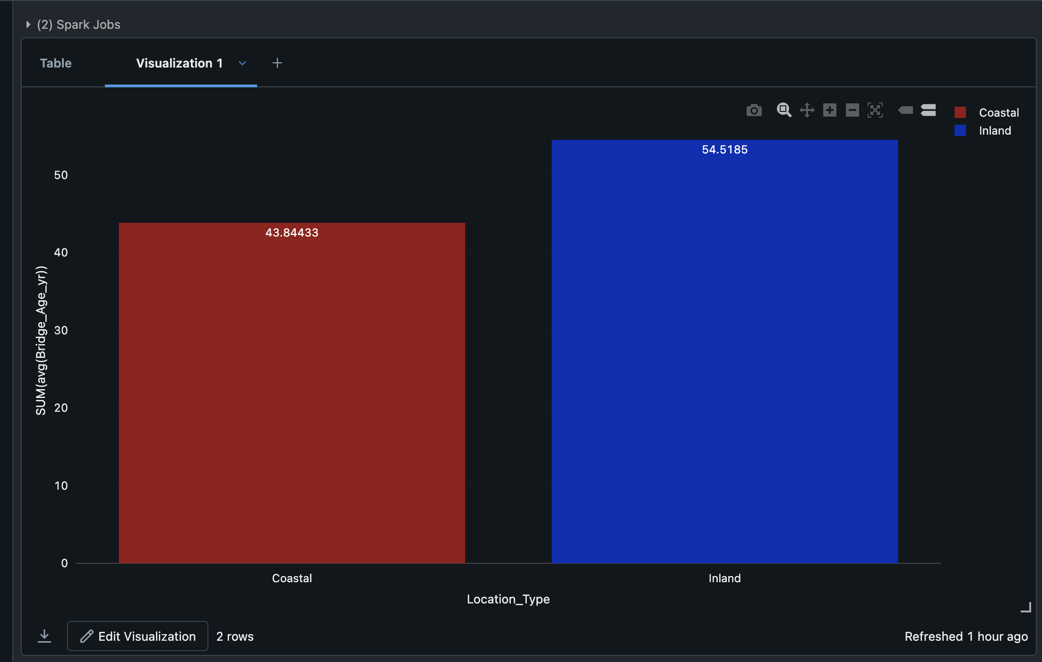
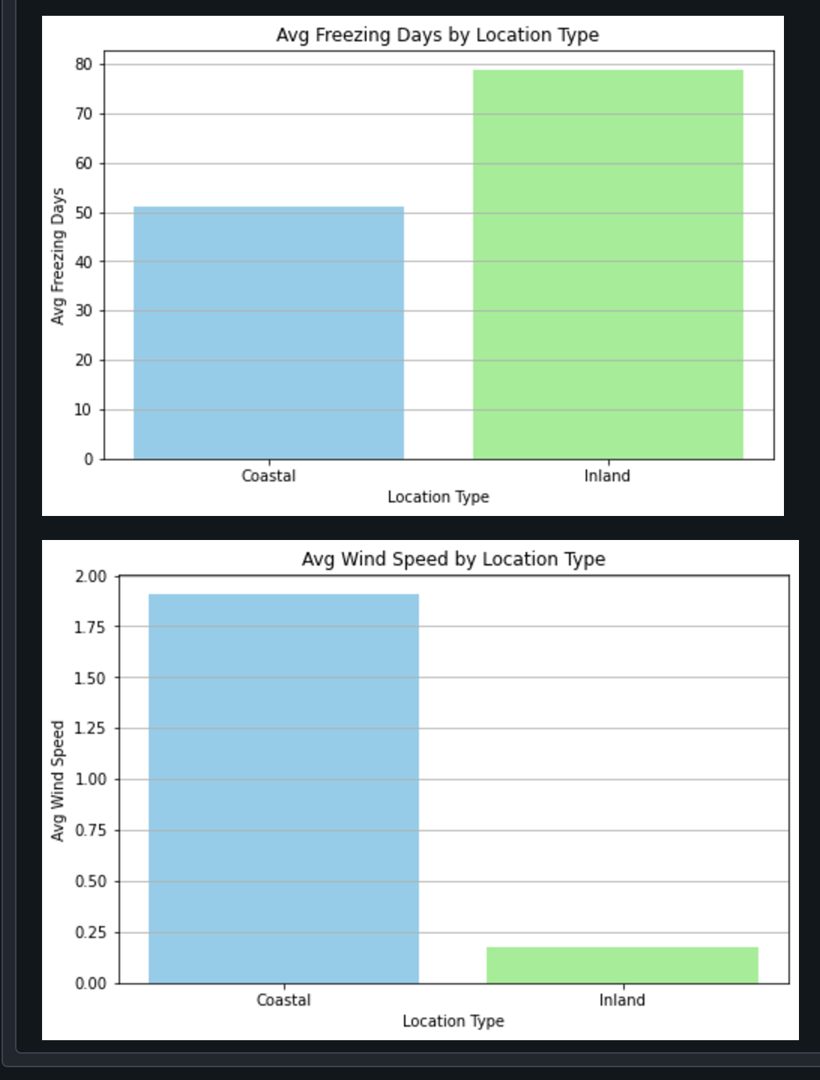
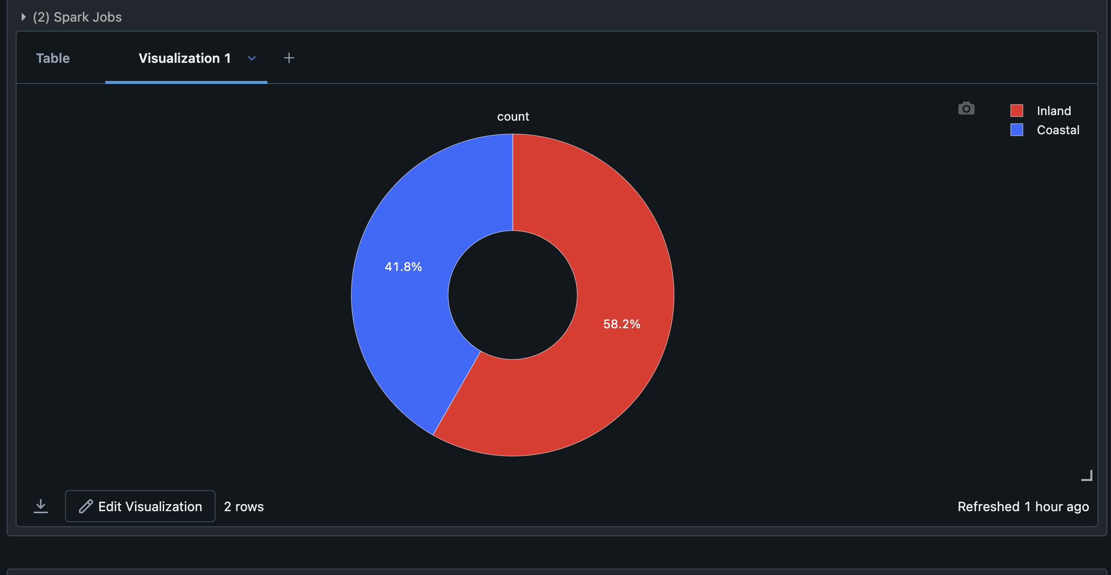
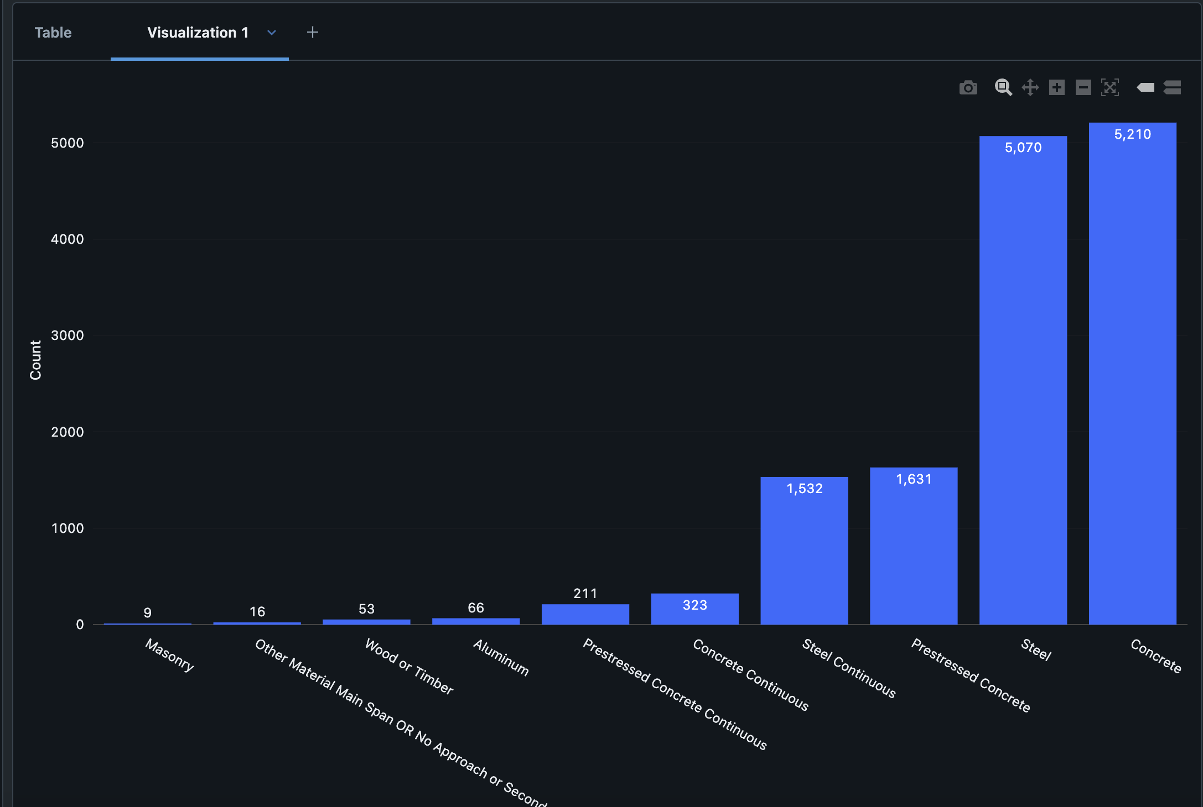
Data Exploration (EDA)

Slide 10
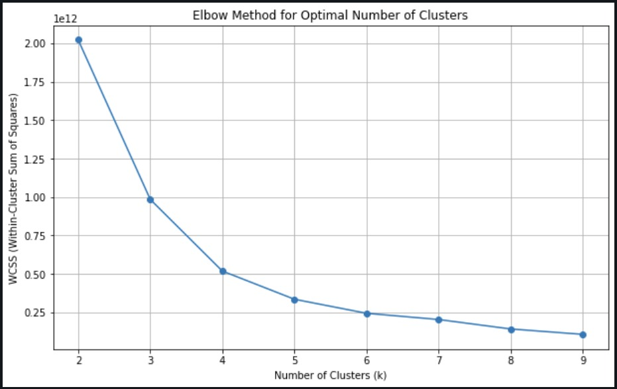
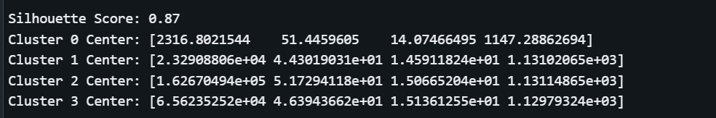
Data Modelling
Elbow Method:
Optimal Number of Clusters:
The Elbow method identifies 4 clusters as the optimal number, where the decrease in WCSS slows significantly, indicating diminishing returns in cluster variability.
Cluster Centers Insights:
Cluster 0:
Represents bridges with lower feature values (e.g., traffic, age, environmental conditions).
Likely lower risk or maintenance requirements.
Cluster 1:
Moderate values across environmental and bridge characteristics.
Indicates moderate risk or maintenance needs.
Cluster 2:
Higher values for temperature and precipitation.
Represents high-risk bridges requiring frequent maintenance.
Cluster 3:
Highest values for all features, representing very high-risk bridges needing priority attention.
Silhouette Score:
Score: 0.87, indicating well-defined and separated clusters.
Implications:
Bridges in Clusters 2 and 3 should be prioritized for maintenance and monitoring due to their high-risk characteristics.
Clusters 0 and 1 can follow a routine maintenance schedule, reducing resource strain.

Slide 11
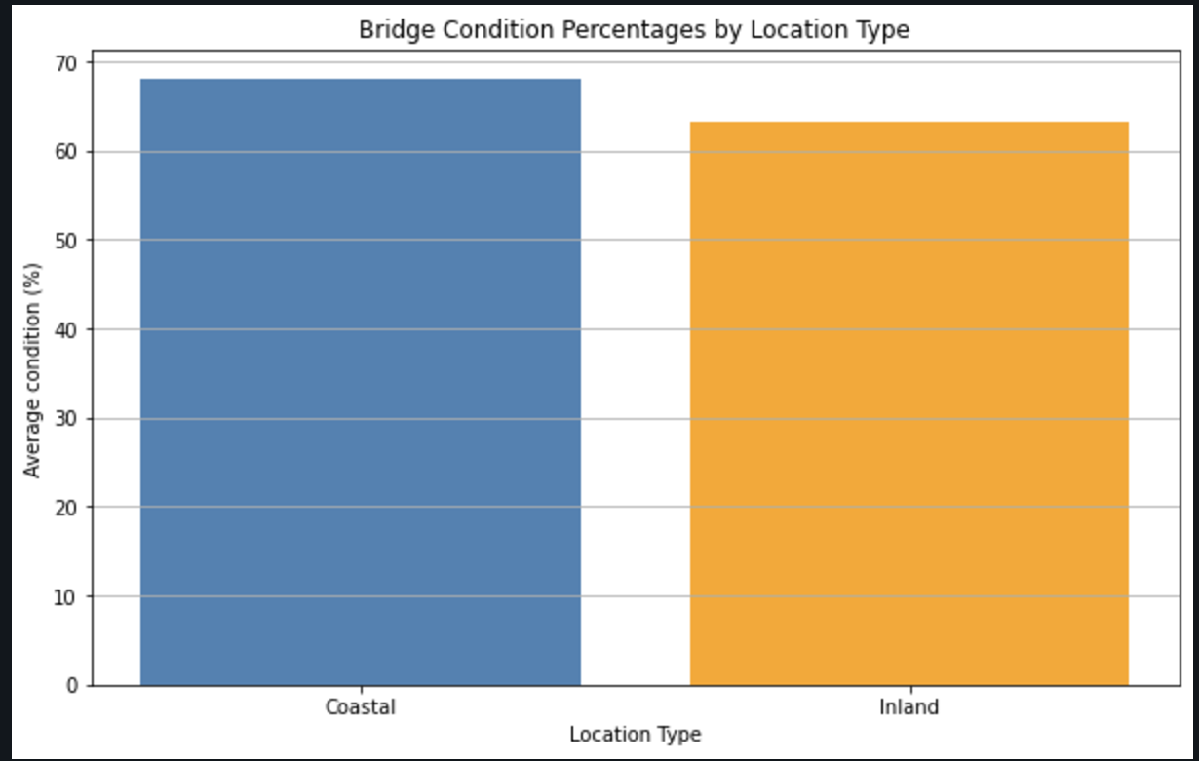
Results and Findings
Average Bridge Condition by Location Type:
Findings:
The average condition score for coastal bridges is 1.297, while for inland bridges, it is slightly lower at 1.286.
Coastal bridges show marginally better conditions compared to inland bridges.
Interpretation:
Inland bridges may require more frequent maintenance due to environmental challenges like freeze-thaw cycles and temperature extremes. These conditions accelerate structural fatigue, leading to cracking and wear over time.
Coastal bridges, despite exposure to humidity and salt, appear to be in relatively better condition. Regular upgrades and corrosion-resistant materials have contributed to their improved ratings.

Slide 12
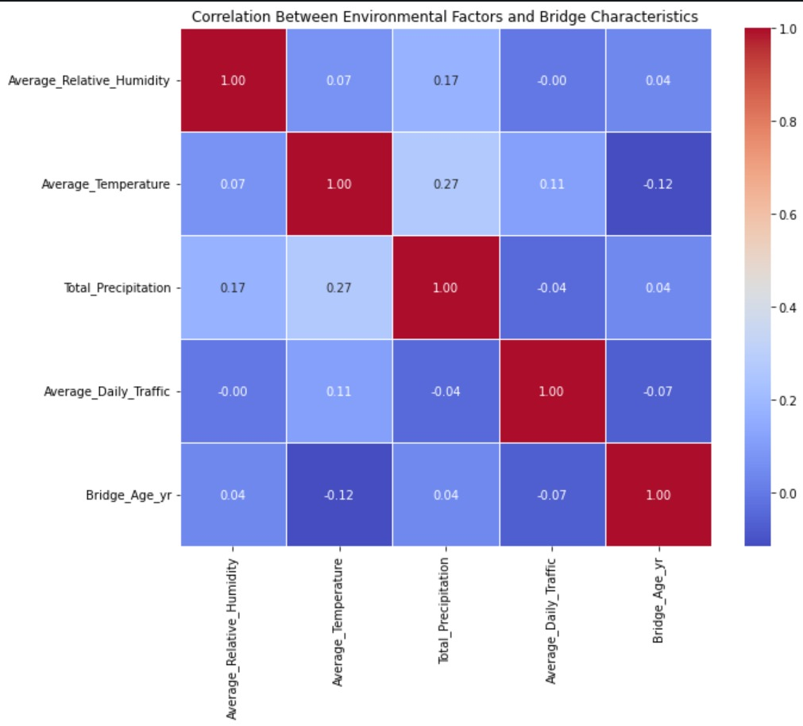
Correlation Between Environmental Factors and Bridge Characteristics:
Average Relative Humidity:
Weak positive correlation with Total Precipitation (0.17).
Negligible correlation with Temperature (0.07), Traffic (-0.00), and Bridge Age (0.04).
Average Temperature:
Moderate positive correlation with Total Precipitation (0.27).
Weak correlation with Traffic (0.11) and negligible correlation with Bridge Age (-0.12).
Total Precipitation:
Moderate positive correlation with Temperature (0.27) and weak correlation with Humidity (0.17).
Negligible correlations with Traffic (-0.04) and Bridge Age (0.04).
Average Daily Traffic:
Slight correlation with Temperature (0.11) and negligible impact on Bridge Age (-0.07).
Bridge Age:
Minimal correlation with environmental factors, implying age is more influenced by maintenance, structural design, and traffic load.

Slide 13
Model Evaluation
Clustering Evaluation:
Silhouette Score: Achieved a high score of 0.87, indicating well-defined clusters.
Applied PCA for visualization in both 2D and 3D.
Predictive Model Evaluation:
Classification Report: Evaluated using Accuracy, Precision, Recall, and F1-score.
Models used:
Random Forest: Feature importance highlights key factors like Bridge Age and Traffic Volume.
XGBoost: Demonstrated strong predictive capabilities with parameter tuning.
MLP (Neural Network): Tuned for optimal hidden layers and iterations.
Statistical Analysis:
Performed T-Tests to compare Coastal vs. Inland bridge characteristics.
Correlation Analysis: Identified moderate correlations between environmental factors and bridge conditions.

Slide 14
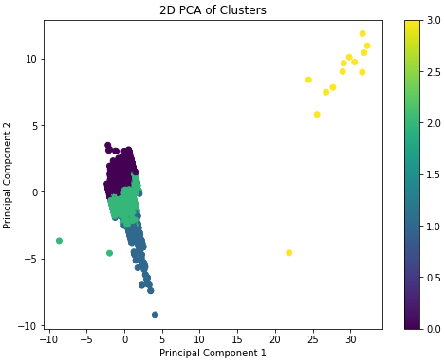
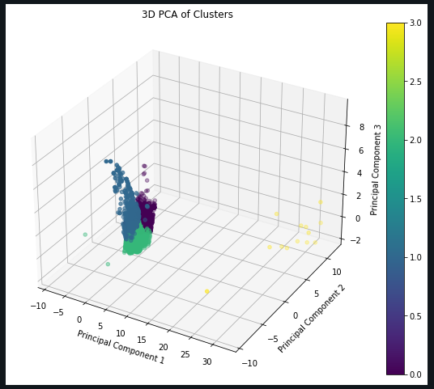
PCA Visualization and Summary Statistics
2D PCA Visualization: The two-dimensional scatterplot illustrates cluster separation using principal components. Each cluster shows distinct patterns, providing insight into how features like bridge conditions and environmental factors influence groupings.
3D PCA Visualization: The three-dimensional plot enhances the clarity of cluster separation, highlighting how the third component adds depth to feature differentiation. This is particularly useful for understanding the variability and interaction between features.
Cluster Summary Statistics:
Cluster 0: Represents the majority of data points with moderate bridge age and low traffic. Indicates less severe environmental impacts.
Cluster 1: Small group with high traffic and moderate precipitation, possibly urban areas requiring frequent maintenance.
Cluster 2: Data reflects older bridges with low traffic but higher precipitation exposure, indicating potential structural risks.
Cluster 3: Extremely small group, representing unique conditions, such as very high precipitation and temperature variances, suggesting rare cases or outliers.
Insights: These clusters can guide resource allocation for bridge inspections, maintenance prioritization, and designing solutions tailored to regional environmental and usage conditions.

Slide 15
Advanced Machine Learning Models for Bridge Risk Prediction
Model Optimization & Performance:
Random Forest (RF):
Best Parameters: n_estimators=300, max_depth=30, min_samples_split=2.
Key Features Identified:
Bridge Age (High importance).
Average Daily Traffic Volume.
Performance: Balanced accuracy across classes with precision in detecting high-risk bridges.
XGBoost:
Best Parameters: learning_rate=0.1, max_depth=7, scale_pos_weight=2.
Key Strengths:
Handles class imbalance (e.g., "Poor" vs. "Good" bridges).
High predictive accuracy: 78%.
MLP Neural Network:
Best Parameters: hidden_layer_sizes=(150, 100), solver=adam, alpha=0.001.
Key Insights:
Captures complex patterns in relationships (e.g., between temperature and bridge conditions).
Performance: Demonstrates robustness with moderate accuracy: 69%.
Ensemble Learning Advantage:
Combines RF, XGBoost, and MLP for higher reliability.
Improves decision-making for prioritizing bridge maintenance.

Slide 16
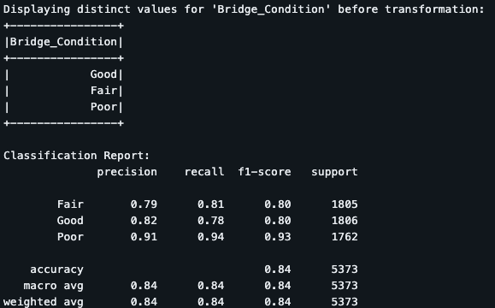
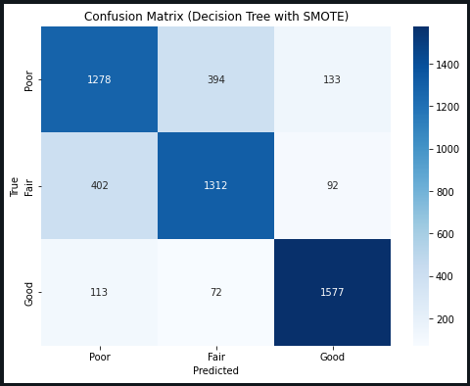
Data Preprocessing and Evaluation Results
Preprocessing Techniques:
Label Encoding: Standardized target labels (Poor, Fair, Good).
SMOTE: Balanced dataset for improved predictive performance.
Train-Test Split: Ensured model validation with 80-20 split.
Evaluation Metrics (Decision Tree with SMOTE):
Confusion Matrix: (Visualize the confusion matrix here using the heatmap image).
High precision and recall for high-risk classes.
Classification Report:
Precision, Recall, F1-Score for each class.
Insights:
Bridges with poor conditions are flagged accurately, ensuring effective resource allocation.
High silhouette score (0.87) confirms distinct clustering of bridge conditions.

Slide 17
Precipitation Analysis Across Temperature and Rainfall Ranges
Key Insights:
Binned Analysis Results:
Bridges in moderate temperature ranges (11.5–34.1°C) and precipitation levels (≤1151.3mm to 3609mm) experience the highest number of measurable precipitation days.
Extreme conditions (very low/high temperatures, high precipitation levels >3609mm) show fewer precipitation days, likely due to concentrated weather events like storms.
Visual Findings:
Bar Plot 1: Displays the relationship between Average Temperature Ranges and Precipitation Days Count, highlighting peak wet conditions in moderate temperature zones.
Bar Plot 2: Illustrates Total Precipitation Ranges and Precipitation Days Count, emphasizing frequent rainfall in moderate precipitation zones.
Implications: Targeted maintenance is critical for moderate regions to address frequent wet conditions and in high-precipitation areas to manage runoff and stress from heavy rainfall.

Slide 18
Insights
Key Findings from Evaluation:
- Clusters with older bridges, high traffic, and adverse environmental factors are at higher risk and require immediate maintenance.
- Coastal bridges show better overall condition despite environmental stressors due to proactive maintenance.
Inland bridges are older, facing more extreme freeze-thaw conditions.
Insights:
- Bridges in Cluster 3 are the highest priority for maintenance as they experience high temperatures, high humidity, heavy daily traffic, and are older structures.
- Bridges in Cluster 2 are the next priority, characterized by high temperatures and significant precipitation levels.
- Bridges in Cluster 1 follow, with moderate temperatures and being relatively younger.
- Bridges in Cluster 0 are the lowest priority since they are recently built and exhibit less risky characteristics.

Slide 19
Conclusions
This study integrates data preprocessing, clustering, and predictive modeling to evaluate environmental impacts on bridge conditions.
Outcomes:
- Provided a framework for risk prediction.
- Supported resource allocation and maintenance prioritization.
- Contributed to resilient and sustainable infrastructure development.

Slide 20
Acknowledgment
Dr. Lindi Liao:
We deeply thank our professor for her guidance and support throughout this project. Her expertise and valuable advice made a significant difference.
Ravi Rachuri:
A special thanks to our teaching assistant for addressing technical questions and providing immense support for the project.
George Mason University:
We acknowledge the university for its resources and support that facilitated this research.
Federal Highway Administration:
We appreciate the invaluable data provided, which was crucial to our work.
Family and Friends:
We thank our loved ones for their continued support and encouragement during this journey.
This project has been a wonderful learning experience, and we are grateful to everyone who contributed to its success.

Slide 21
References
Data - LTBP InfoBridge. (n.d.). https://infobridge.fhwa.dot.gov/Data/
Ph.D., J. M., & Kavlakoglu, E. (2024, August 15). What is ensemble learning?. IBM. https://www.ibm.com/topics/ensemble-learning#:~:text=Ensemble%20learning%20is%20a%20machine,than%20a%20single%20model%20alone/
American Institute of Steel Construction (AISC). "Steel Bridge Design Handbook." https://www.aisc.org/nsba/design-and-estimation-resources/steel-bridge-design-handbook/.
Neumann, J. E., Price, J., Chinowsky, P., Wright, L., Ludwig, L., Streeter, R., Jones, R., Smith, J. B., Perkins, W., Jantarasami, L., & Martinich, J. (2014). Climate change risks to US infrastructure: impacts on roads, bridges, coastal development, and urban drainage. Climatic Change, 131(1), 97–109. https://doi.org/10.1007/s10584-013-1037-4
Correlations Between Sets of Data for Investigating Bridge Conditions in Virginia. (2024). ScholarSpace. https://scholarspace.library.gwu.edu/concern/gw_etds/5x21tg31d

Slide 22

By Team 1

